Slide 1
DataBase

Slide 2
2nd year DataBase course introduces fundamental concepts necessary for designing, using, and implementing database systems and database applications
present the most important aspects of database systems and applications, and related technologies
assume that students are familiar with mathematics, elementary programming and data-structuring concepts and that they have had some exposure to the basics of computer organizations IT

Slide 3
Databases

Slide 4
Database – Wikipedia https://en.wikipedia.org/wiki/Database
in computing,
a database is an organized collection of data
or
a type of data store based on the use of a DataBase Management System (DBMS), the software that interacts with end users, applications, and the database itself to capture and analyze the data
sum total of the database, the DBMS and the associated applications can be referred to as a database system
often term "database" is also used loosely to refer to any of DBMS, database system or application associated with database

Slide 5
Database – Wikipedia https://en.wikipedia.org/wiki/Database
before digital storage and retrieval of data have become widespread, index cards were used for data storage in a wide range of applications and environments:
  in the home to record and store recipes, shopping lists, contact information and other organizational data;
  in business to record presentation notes, project research and notes, and contact information;
  in schools as flash cards or other visual aids;
  in academic research to hold data such as bibliographical citations or notes in a card file; professional book indexers used index cards in the creation of book indexes until they were replaced by indexing software

Slide 6
Database – Wikipedia https://en.wikipedia.org/wiki/Database
small databases can be stored on file system or document database
large databases are hosted on computer clusters or cloud storage
design of databases spans formal techniques and practical considerations, including data modeling, efficient data representation and storage, query languages, security and privacy of sensitive data, and distributed computing issues, including supporting concurrent access and fault tolerance

Slide 7
Database – Wikipedia https://en.wikipedia.org/wiki/Database
IT computer scientists may classify database management systems according to the database models that they support
Relational databases became dominant in the 1980s
  these model data as rows and columns in a series of tables, and the vast majority use SQL for writing and querying data
Object Relational DataBase Management Systems
  Oracle, SQL Server PostgreSQL
non-relational databases, referred to as NoSQL, became popular in the 2000s

Slide 8
databases and database systems are an essential component of life in modern society: most of us encounter several activities every day that involve some interaction with a database
for example,
  if we go to the bank to deposit or withdraw funds
  if we make a hotel or airline reservation
  if we access a computerized library catalog to search for a bibliographic item
  if we purchase something online, such as a book, toy, or computer
  If we access SINU or SIS or RMU
chances are that our activities will involve someone or some computer program accessing a database

Slide 9
we
Departamentul Q de Informatica al UTCN https://websinu.utcluj.ro/
Sistemul informatic al studenților https://sis-admin-staging.utcluj.app/

Slide 10
me
Sistemul informatic al studenților https://sis-admin-staging.utcluj.app/

Slide 11
you
Platforma REI Registru Educational Integrat https://rei.gov.ro/

Slide 12
databases and database systems are an essential component of life in modern society: most of us encounter several activities every day that involve some interaction with a database
for example,
  if we go to the bank to deposit or withdraw funds
  if we make a hotel or airline reservation
  if we access a computerized library catalog to search for a bibliographic item
  if we purchase something online, such as a book, toy, or computer
  If we access SINU or SIS or RMU
chances are that our activities will involve someone or some computer program accessing a database

Slide 13
examples of what we may call traditional database applications, in which most of the information that is stored and accessed is structured, either textual or numeric

Slide 14
in the past few years, advances in technology have led to new applications of database systems: social media such as Facebook among many others, has required the creation of huge databases that store nontraditional data, such as posts, tweets, images, and video clips
new types of database systems, often referred to as big data storage systems, or NOSQL systems, have been created to manage less structured data for such applications
these types of systems are also used by companies such as Google, Amazon, and Yahoo, to manage the data required in their Web search engines, as well as to provide cloud storage, whereby users are provided with storage capabilities on the Web for managing all types of data including documents, programs, images, videos and emails

Slide 15
wide availability of photo and video technology on mobile phones and devices has made it possible to store images, audio clips, and video streams digitally becoming important component of multimedia databases
Geographic Information Systems (GISs) can store and analyze maps, weather data, and satellite images
Data warehouses and OnLine Analytical Processing (OLAP) systems are used in many companies to extract and analyze useful business information from very large databases to support decision making

Slide 16
Real-time and active database technology is used to control industrial and manufacturing processes
database search techniques are being applied to World Wide Web to improve the search for information that is needed by users browsing the Internet

Slide 17
to understand the fundamentals of database technology, must start from the basics of traditional database applications

Slide 18
database
a database is a collection of related data
by data, mean known facts that can be recorded and that have meaning
for example, consider the names, telephone numbers, and addresses of the people you know; data is typically stored in mobile devices, which have their own simple SQLite database software
data can also be recorded in indexed address book or stored on a document in a file system on hard drive, using personal computer and software such as Microsoft Access or Excel, FileMaker, SQLite, … document databases
collection of related data with an implicit meaning is a database

Slide 19
database properties
database represents some aspect of real world, sometimes called domain, miniworld or universe of discourse; changes to miniworld are reflected in the database
database is a logically coherent collection of data with some inherent meaning - random assortment of data cannot be referred to as database
database is designed, built, and loaded with data for specific purpose; has an intended group of users and some preconceived applications in which these users are interested

Slide 20
database has
some source from which data is derived
some degree of interaction with events in real world
audience that is actively interested in its contents
users of a database may perform business transactions
database can be of any size and complexity

Slide 21
database may be
generated and maintained manually by hand
or it may be computerized in file systems, Excel or a database server

Slide 22
database
a database is a collection of related data
by data, mean known facts that can be recorded and that have meaning
for example, consider the names, telephone numbers, and addresses of the people you know; data is typically stored in mobile devices, which have their own simple SQLite database software
data can also be recorded in indexed address book or stored on a document in a file system on hard drive, using personal computer and software such as Microsoft Access or Excel, FileMaker, SQLite, … document databases
collection of related data with an implicit meaning is a database

Slide 23
DataBase Management System (DBMS)
is a computerized system that enables users to create and maintain a database
software system that facilitates processes of defining, constructing, manipulating, and sharing databases among various users and applications

Slide 24
defining database involves specifying data types, structures, and constraints of data to be stored in database - database definition or descriptive information is stored by tDBMS in the form of a database catalog or dictionary called meta-data
constructing database is the process of storing data on some storage medium that is controlled by DBMS
manipulating database includes functions such as querying database to retrieve specific data, updating database to reflect changes in the miniworld, and generating reports from data
sharing database allows multiple users and programs to access the database simultaneously

Slide 25
a database application program accesses database by sending queries or requests for data to the DBMS
query typically causes some data to be retrieved
transaction may cause some data to be read and some data to be written into database

Slide 26
Example University database
for maintaining information concerning students, courses, and grades in a university environment
database is organized as five files
  STUDENT file stores data on each student
  COURSE file stores data on each course (DataBase is course)
  SECTION file stores data on each section of a course (DataBase English 1st series and 2nd series are section)
  GRADE_REPORT file stores grades that students receive
  PREREQUISITE stores the prerequisites of each course

Slide 27
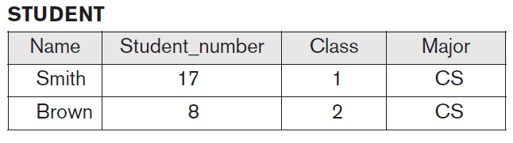

Slide 28
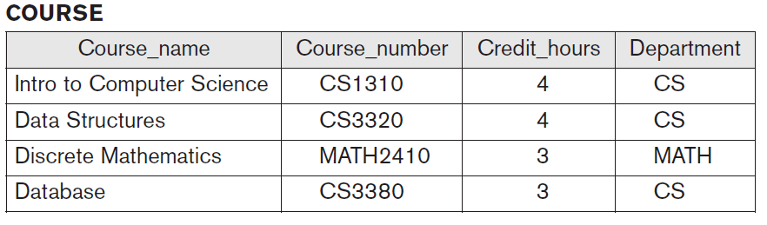

Slide 29
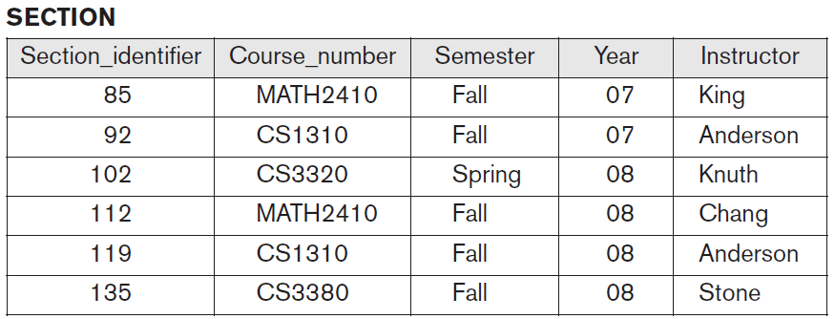

Slide 30
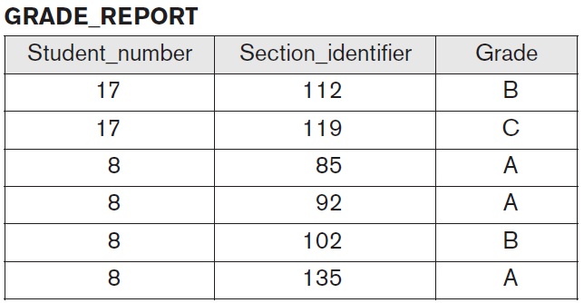

Slide 31
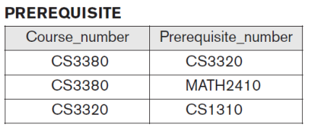

Slide 32
store data to represent each student, course, section, grade report, and prerequisite as record in appropriate file
records in various files may be related; for example, the record for Smith in the STUDENT file is related to two records in the GRADE_REPORT file that specify Smith’s grades in two sections
most medium-size and large databases include many types of records and have many relationships among records

Slide 33
information system within an organization
SINU, SIS, …
analysis and requirements specification
conceptual design
logical design
physical design

Slide 34
Database approach vs traditional file processing
traditional file processing, each user defines and implements the files needed for a specific software application as part of programming the application
for example, the grade reporting office keep files on students and their grades; the accounting office keep track of students’ fees and their payments - although both users are interested in data about students, each user maintains separate files and programs to manipulate these files
redundancy in defining and storing data results in wasted storage space and in redundant efforts to maintain common up-to-date data

Slide 35
Database approach
single repository maintains data that is defined once and then accessed by various users repeatedly through queries, transactions, and application programs
main characteristics of the database approach versus file-processing
  self-describing nature of a database system
  data independence - insulation between programs and data, and data abstraction
  support of multiple views of the data
  sharing of data and multiuser transaction processing

Slide 36
Self-Describing Nature of a Database System
definition is stored in DBMS catalog, which contains information such as the structure of each file, type and storage format of each data item, and various constraints on data; information stored in catalog is called meta-data
in traditional file processing, data definition is typically part of application programs themselves; these programs are constrained to work with only one specific database, whose structure is declared in the application programs
NoSQL systems, do not require meta-data, rather the data is stored as self-describing data that includes the data item names and data values together in one structure

Slide 37
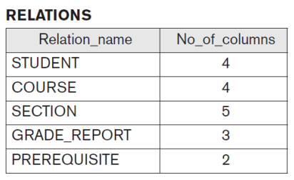

Slide 38
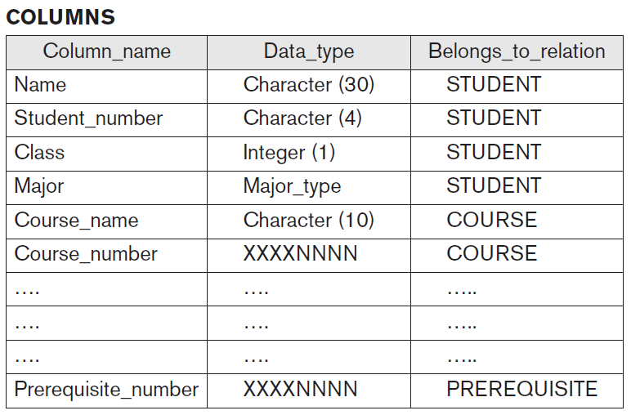

Slide 39
Data Independence Insulation between Programs and Data, and Data Abstraction
in traditional file processing, structure of data files is embedded in application programs, so any changes to structure of file may require changing all programs that access that file
DBMS access programs do not require such changes in most cases
structure of data files is stored in DBMS catalog separately from the access programs

Slide 40
in some types of database systems, such as object-oriented and object-relational systems, users can define operations (also called a function or method) on data as part of database definitions; application programs can operate on data by invoking these operations

Slide 41
characteristic that allows program-data independence is called data abstraction
DBMS provides users with a conceptual representation of data that does not include many of the details of how the data is stored or how the operations are implemented
data model is a type of data abstraction that is used to provide this conceptual representation; uses logical concepts, such as objects, their properties, and their interrelationships, that may be easier for most users to understand than computer storage concepts
hence, data model hides storage and implementation details that are not of interest to most database users

Slide 42
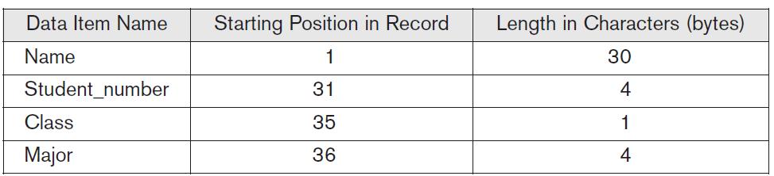
internal storage format for a STUDENT record, based on database catalog

Slide 43
Support of Multiple Views of the Data
database typically has many types of users, each of whom may require different perspective or view of database; view may be subset of database or it may contain virtual data that is derived from database files but is not explicitly stored
users may not need to be aware of whether data they refer to is stored or derived

Slide 44
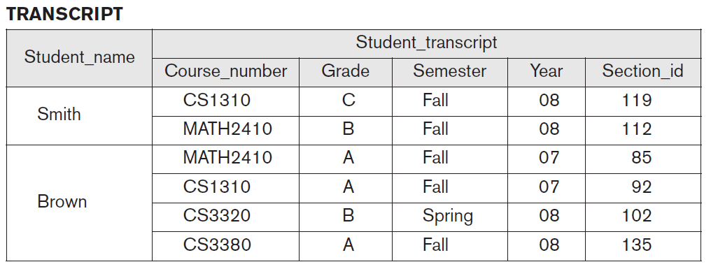
one user of database may be interested only in accessing the transcript of each student

Slide 45
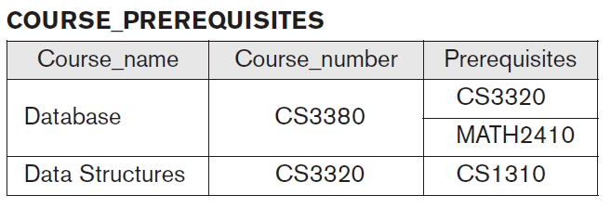
other user is interested only in checking that students have taken all prerequisites of each course for which the student registers

Slide 46
Sharing of Data and Multiuser Transaction Processing
DBMS must allow multiple users to access database at same time
DBMS must include concurrency control software to ensure that several users trying to update same data do so in a controlled manner
DBMS software is to ensure that concurrent transactions operate correctly and efficiently
transaction is an executing program or process that includes one or more database accesses, such as reading or updating of database records; each transaction is supposed to execute a logically correct database access if executed in its entirety without interference from other transactions

Slide 47
DataBase Users

Slide 48
Database Administrators DBA
chief administrator to oversee and manage these database resources
responsible for authorizing access to database, coordinating and monitoring its use, and acquiring software and hardware resources as needed
accountable for problems such as security and poor system response time

Slide 49
Database Designers
responsible for identifying data to be stored in database and for choosing appropriate structures to represent this data
mostly undertaken before database is actually implemented and populated with data
communicate with all prospective users in order to understand their requirements and to create design that meets these requirements
interact with each potential group of users and develop views of database that meet data and processing requirements of these groups

Slide 50
End Users
people whose jobs require access to database for querying, updating, and reports; the database primarily exists for their use
there are several categories of end users:
  Casual End users
  Naive or parametric End users
  Sophisticated End users

Slide 51
Casual End users
occasionally access database, but they may need different information each time
use a sophisticated database query interface to specify their requests and are typically occasional browsers

Slide 52
Naive or parametric End users
main job function revolves around constantly querying and updating the database, using standard types of queries and updates called canned transactions that have been carefully programmed and tested

Slide 53
Sophisticated End users
include engineers, scientists, business analysts, and others who thoroughly familiarize themselves with facilities of DBMS in order to implement their own applications to meet their complex requirements

Slide 54
Standalone users
maintain personal databases by using ready-made program packages that provide easy-to-use menu-based or graphics-based interfaces
an example is the user of a financial software package that stores a variety of personal financial data

Slide 55
System Analysts and Application Programmers
(Software Engineers)
system analysts determine the requirements of end users, especially naive and parametric end users, and develop specifications for standard canned transactions that meet these requirements
application programmers implement these specifications as programs; then they test, debug, document, and maintain these canned transactions
software developers or software engineers should be familiar with full range of capabilities provided by DBMS to accomplish their tasks

Slide 56
DBMS system designers and implementers
design and implement DBMS modules and interfaces as software package
complex software system that consists of many components, or modules
  implementing the catalog, query language processing, interface processing, accessing and buffering data, controlling concurrency, and handling data recovery and security
  DBMS must interface with other system software, such as the operating system and compilers for various programming languages

Slide 57
Advantages of using DBMS
Controlling Redundancy
Restricting Unauthorized Access
Providing Persistent Storage for Program Objects
Providing Storage Structures and Search Techniques for Efficient Query Processing
Providing Backup and Recovery
Providing Multiple User Interfaces
Representing Complex Relationships among Data
Enforcing Integrity Constraints

Slide 58
Potential for Enforcing Standards
Reduced Application Development Time
Flexibility
Availability of Up-to-Date Information
Economies of Scale

Slide 59
History

Slide 60
Early Database Applications Using Hierarchical and Network Systems Data Models
many early database applications maintained records in large organizations such as corporations, universities, hospitals, and banks
there were large numbers of records of similar structure
there were also many types of records and many interrelationships among them
intermixing of conceptual relationships with the physical storage and placement of records on disk
systems did not provide sufficient data abstraction and program-data independence capabilities

Slide 61
provided only programming language interfaces
  time-consuming and expensive to implement new queries and transactions
implemented on large and expensive mainframe computers
based on three main paradigms:
  hierarchical systems
  network model–based systems
  inverted file systems

Slide 62
Data Abstraction and Application Flexibility with Relational Databases
relational databases were originally proposed to separate physical storage of data from its conceptual representation and to provide sound mathematical foundation for data representation and querying
Introduced high-level query languages that provided an alternative to programming language interfaces, making it much faster to write new queries
data abstraction and program-data independence were much improved when compared to earlier systems

Slide 63
1970: Birth of the Relational Model
concept of relational databases emerged in 1970 with Edgar F. Codd's groundbreaking paper, "A Relational Model of Data for Large Shared Data Banks," introducing a new way to model and manage data; model, which stores data in tables and uses SQL for queries, revolutionized data management by emphasizing data integrity and reducing redundancy
E.F. Codd, a mathematician at IBM, proposed the relational model, which organized data into tables (relations) with rows (tuples) and columns (attributes). This model used relational algebra and calculus for data manipulation. Codd's work was a direct response to the limitations of earlier hierarchical and network database models, which were complex and difficult to query efficiently

Slide 64
Early Implementations
while Codd's paper laid theoretical foundation, it took time to translate into practical systems; early prototypes were developed at IBM and other institutions, but the first commercial relational database, Oracle Version 2, wasn't released until 1979.

Slide 65
Rise of SQL
Structured Query Language (SQL) emerged as the standard language for interacting with relational databases
SQL allowed users to retrieve, manipulate, and manage data through a declarative language, abstracting physical implementation details from the user

Slide 66
1980: Commercial
Relational DataBase Management Systems (RDBMS)
like Oracle and IBM DB2 gained popularity in the 1980s, solidifying the relational model's position as the standard for data management

Slide 67
Dominance in the 1980s and 90s
relational databases became increasingly popular due to their efficiency, ease of use, and ability to handle complex queries
commercial systems like Oracle, IBM DB2, and Microsoft SQL Server gained widespread adoption, becoming the cornerstone of enterprise data management

Slide 68
Continued Evolution
relational databases have continued to evolve, incorporating advancements in scalability, performance, and support for new data types
even with the rise of other database models like NoSQL, relational databases remain a dominant force in the database landscape.
in essence, the relational database model, with its structured approach and the power of SQL, fundamentally changed how we store, access, and manage information, and it continues to be a vital technology in the modern world.

Slide 69
early experimental relational systems developed in late 1970s and commercial relational database management systems (RDBMS) introduced in early 1980s were quite slow; with development of new storage and indexing techniques and better query processing and optimization, their performance improved
eventually, relational databases became dominant type of database system for traditional database applications

Slide 70
Object-Oriented Applications and the Need for More Complex Databases
emergence of object-oriented programming languages in the 1980s and the need to store and share complex, structured objects led to the development of object-oriented databases (OODBs)
initially, OODBs were considered a competitor to relational databases, since they provided more general data structures; also incorporated many of useful object-oriented paradigms, such as abstract data types, encapsulation of operations, inheritance, and object identity
complexity of the model and the lack of an early standard contributed to their limited use
now mainly used in specialized applications, such as engineering design, multimedia publishing, and manufacturing systems

Slide 71
Object-Oriented Applications and the Need for More Complex Databases
many object-oriented concepts were incorporated into newer versions of relational DBMSs, leading to Object-Relational DataBase Management Systems
Oracle – relational storage, Java integration and other programming languages …
SQL Server – relational storage, C# .NET integration and other programming languages …
PostgreSQL – relational storage, Python integration and other programming languages …

Slide 72
Interchanging Data on the Web Using XML
a variety of techniques were developed to allow the interchange of dynamically extracted data on the Web for display
the eXtended Markup Language (XML) is one standard for interchanging data among various types of databases and Web pages
XML combines concepts from the models used in document systems with database modeling concepts

Slide 73
Extending Database Capabilities for New Applications
such applications traditionally used their own specialized software and file and data structures
database systems now offer extensions to better support the specialized requirements for some of these applications

Slide 74
Extending Database Capabilities for New Applications
Scientific applications that store large amounts of data resulting from scientific experiments in areas such as high-energy physics, the mapping of the human genome, and the discovery of protein structures
storage and retrieval of images, including scanned news or personal photographs, satellite photographic images, and images from medical procedures such as x-rays and MRI (magnetic resonance imaging) tests
storage and retrieval of videos, such as movies, and video clips from news or personal digital cameras

Slide 75
Extending Database Capabilities for New Applications
Data mining applications that analyze large amounts of data to search for the occurrences of specific patterns or relationships, and for identifying unusual patterns in areas such as credit card fraud detection

Slide 76
Extending Database Capabilities for New Applications
Spatial applications that store and analyze spatial locations of data, such as weather information, maps used in geographical information systems, and automobile navigational systems

Slide 77
Extending Database Capabilities for New Applications
Time series applications that store information such as economic data at regular points in time, such as daily sales and monthly gross national product figures

Slide 78
Extending Database Capabilities for New Applications
it was quickly apparent that basic relational systems were not very suitable for many of these applications, usually for one or more of following reasons:
  more complex data structures were needed for modeling application than simple relational representation
  new data types were needed in addition to basic numeric and character string types
  new operations and query language constructs were necessary to manipulate new data types
  new storage and indexing structures were needed for efficient searching on new data types

Slide 79
this led DBMS developers to add functionality to their systems
some functionality was general purpose, such as incorporating concepts from object-oriented databases into relational systems
other functionality was special purpose, in the form of optional modules that could be used for specific applications
  for example, users could incorporate a time series / GIS module to use with their relational DBMS for their time series / GIS application

Slide 80
Emergence of Big Data Storage Systems and NOSQL Databases
first decade of twenty-first century, proliferation of applications and platforms such as social media Web sites, large e-commerce companies, Web search indexes, and cloud storage led to a surge in the amount of data stored on databases
new types of database systems were necessary to manage these huge databases - systems that would provide fast search and retrieval as well as reliable and safe storage of less structured data and nontraditional types of data, such as social media posts and tweets

Slide 81
Emergence of Big Data Storage Systems and NOSQL Databases
some of the requirements of these new systems were not compatible with SQL relational DBMSs
term NOSQL is generally interpreted as Not only SQL, meaning that in systems than manage large amounts of data, some of the data is stored using SQL systems, whereas other data would be stored using NoSQL, depending on the application requirements

Slide 82
Database System
Concepts and Architecture

Slide 83
Data Abstraction
refers to suppression of details of data organization and storage, and highlighting of essential features
so that different users can perceive data at their preferred level of detail

Slide 84
Data Model
collection of concepts that can be used to describe the structure of a database; provides necessary means to achieve this data abstraction
by structure of database, we mean data types, relationships, and constraints that apply to data
most data models also include a set of basic operations for specifying retrievals and updates on database

Slide 85
high-level or conceptual data models provide concepts that are close to the way many users perceive data
low-level or physical data models provide concepts that describe the details of how data is stored on computer storage media
  concepts meant for computer specialists, not for end users
between these two extremes is a class of representational (or implementation) data models ;hide many details of data storage on disk but can be implemented on computer system directly

Slide 86
Conceptual Data Models
use concepts such as entities, attributes, and relationships
an entity represents a real-world object or event or concept, such as an employee or a project from the miniworld that is described in database
an attribute represents some property of interest that further describes an entity, such as the employee’s name or salary
a relationship among two or more entities represents an association among the entities, for example, a works-on relationship between an employee and a project

Slide 87
Representational or implementation
Data Models
used most frequently in traditional commercial DBMSs; include widely used relational data model, as well as so-called legacy data models: network and hierarchical models that have been widely used in the past
representational data models represent data by using record structures and hence are sometimes called record-based data models

Slide 88
can view the object data model as an example of a new family of higher-level implementation data models that are closer to conceptual data models

Slide 89
Physical Data Models
describe how data is stored as files in computer by representing information such as record formats, record orderings, and access paths
an access path is a search structure that makes the search for particular database records efficient, such as indexing or hashing
an index is an example of an access path that allows direct access to data using an index term or a keyword

Slide 90
self-describing data models
data storage in systems based on these models combines description of data with the data values themselves
include XML as well as many of the key-value stores, document database, JSON and other NoSQL systems that were recently created for managing big data

Slide 91
Database Schema and Instances
in a data model, it is important to distinguish between description of database and database itself
description of a database is called database schema, which is specified during database design and is not expected to change frequently
most data models have certain conventions for displaying schemas as diagrams; displayed schema is called a schema diagram
diagram displays the structure of each record type but not the actual instances of records

Slide 92
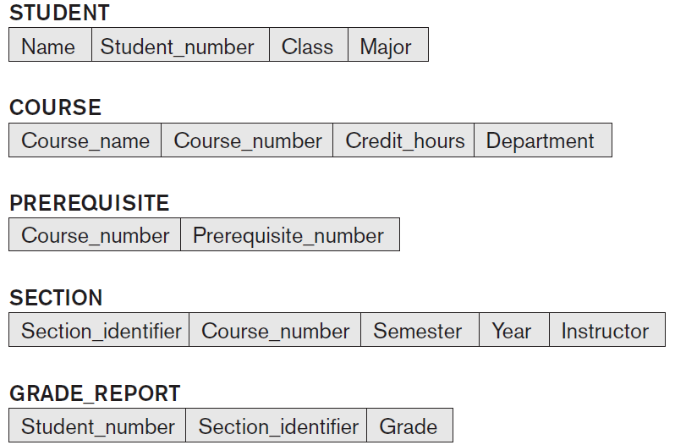

Slide 93
schema diagram displays only some aspects of a schema, such as names of record types and data items, and some types of constraints
many types of constraints are not represented in schema diagrams

Slide 94
actual data in a database may change quite frequently
data in the database at a particular moment in time is called a database state or snapshot
also called the current set of occurrences or database instances
every time we insert, update or delete a record or value of a data item in record, we change one state of the database into another state

Slide 95
DBMS is responsible for ensuring that every state of database is a valid state - that is, state that satisfies the structure and constraints specified in schema
schema is sometimes called the intension, and database state is called an extension of the schema

Slide 96
Three-Schema Architecture and Data Independence
internal level has an internal schema
conceptual level has a conceptual schema
external or view level includes a number of external schemas or user views

Slide 97
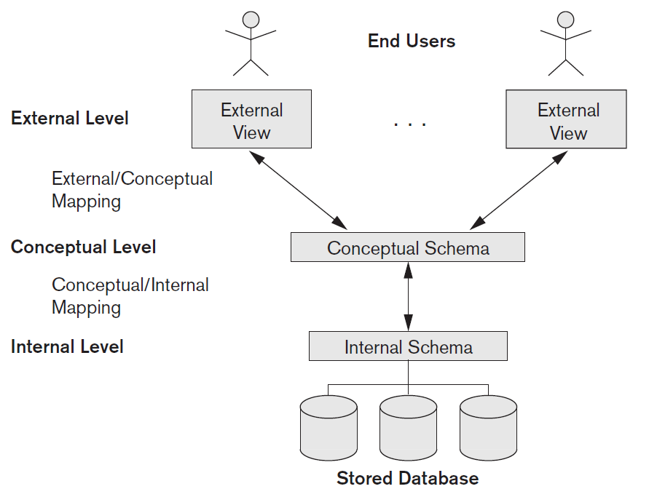

Slide 98
internal level has an internal schema, which describes the physical storage structure of the database
uses a physical data model and describes the complete details of data storage and access paths for the database

Slide 99
conceptual level has a conceptual schema, which describes structure of the whole database for a community of users; conceptual schema hides the details of physical storage structures and concentrates on describing entities, data types, relationships, user operations, and constraints
representational data model is used to describe conceptual schema when database system is implemented
this implementation conceptual schema is often based on conceptual schema design in a high-level data model

Slide 100
external or view level includes a number of external schemas or user views; each external schema describes the part of the database that a particular user group is interested in and hides the rest of the database from that user group
implemented using a representational data model, possibly based on an external schema design in a high-level conceptual data model

Slide 101
three-level ANSI architecture has an important place in database technology development because it clearly separates users’ external level, database’s conceptual level, and internal storage level for designing a database
applicable in the design

Slide 102
processes of transforming requests and results between levels are called mappings

Slide 103
Data Independence
The three-schema architecture can be used to further explain the concept of data independence, which can be defined as the capacity to change the schema at one level of a database system without having to change the schema at the next higher level
logical data independence
physical data independence

Slide 104
Logical Data Independence
is the capacity to change conceptual schema without having to change external schemas or application programs
we may change conceptual schema to expand database (by adding a record type or data item), to change constraints, or to reduce the database (by removing a record type or data item)
external schemas that refer only to remaining data should not be affected
only the view definition and the mappings need to be changed in a DBMS that supports logical data independence
after conceptual schema undergoes a logical reorganization, application programs that reference external schema constructs must work as before

Slide 105
changes to constraints can be applied to conceptual schema without affecting external schemas or application programs

Slide 106
Physical Data Independence
capacity to change the internal schema without having to change the conceptual schema
changes to internal schema may be needed because some physical files were reorganized for example, by creating additional access structures to improve performance of retrieval or update
if same data as before remains in database, we should not have to change the conceptual schema

Slide 107
DBMS Languages
Data Definition Language (DDL)
Data Manipulation Language (DML)

Slide 108
Data Definition Language
to specify conceptual and internal schemas for the database and any mappings between the two
used by DBA and by database designers to define both conceptual and internal schemas
DBMS process DDL statements in order to identify descriptions of schema constructs and to store schema description in DBMS catalog
storage definition language
view definition language
SQL Data Definition Language CREATE VIEW, TABLE, INDEX define external, conceptual and internal physical schemas

Slide 109
Data Manipulation Language
users must have some means to manipulate the database
include CRUD retrieval, insertion, deletion, and modification of data

Slide 110
two main types of DMLs
high-level or nonprocedural DML
low-level or procedural DML

Slide 111
a high-level or nonprocedural DML can be used on its own to specify complex database operations concisely
high-level DML statements either to be entered interactively or to be embedded in a general-purpose programming language

Slide 112
A low-level or procedural DML embedded in a general-purpose programming language
typically retrieves individual records or objects from the database and processes each separately; use programming language constructs, such as looping, to retrieve and process each record from a set of records

Slide 113
low-level DMLs are also called record-at-a-time DMLs
high-level DMLs can specify and retrieve many records in a single DML statement; therefore, they are called set-at-a-time or set-oriented DMLs
query in high-level DML often specifies which data to retrieve rather than how to retrieve it; therefore, such languages are also called declarative

Slide 114
whenever DML commands, whether high level or low level, are embedded in a general-purpose programming language, that language is called the host language and the DML is called the data sublanguage
a high-level DML used in a standalone interactive manner is called a query language

Slide 115
DBMS Component Modules
typical DBMS components
top part of figure refers to various users of database environment and their interfaces
lower part shows internal modules of DBMS responsible for storage of data and processing of transactions
database and DBMS catalog are usually stored on disk
access to storage disk is controlled primarily by operating system (OS), which schedules disk read/write; many DBMSs have their own buffer management module to schedule disk read/write, because management of buffer storage has considerable effect on performance

Slide 116
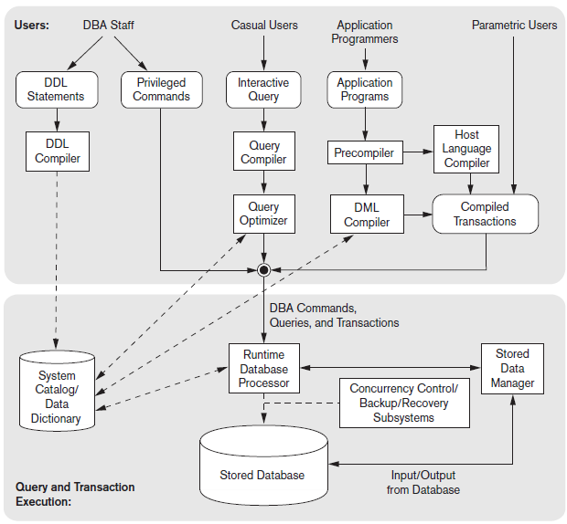

Slide 117
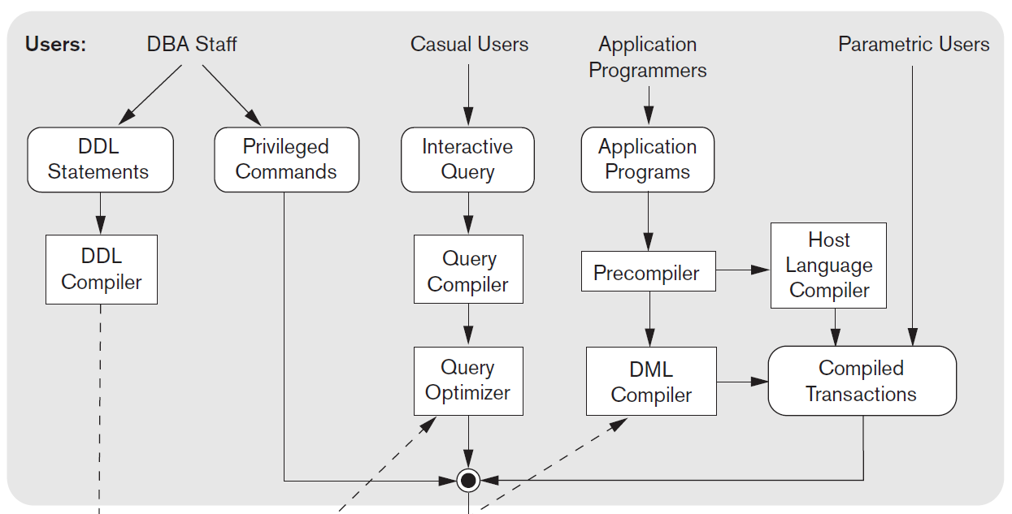

Slide 118
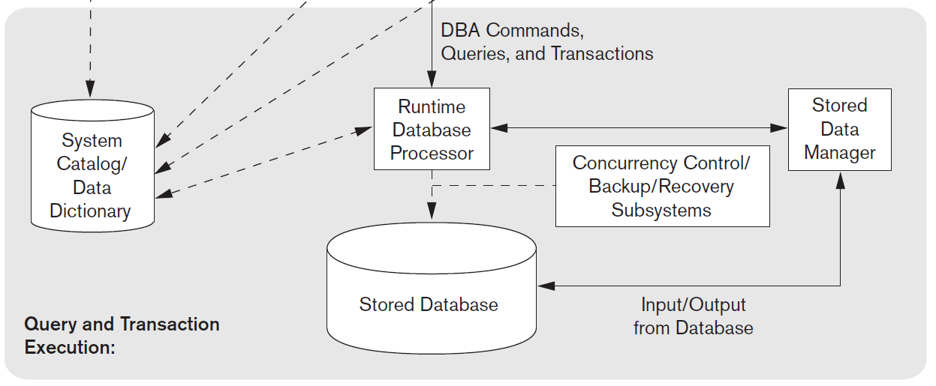

Slide 119
Database System Utilities
Loading
Backup
Database storage reorganization
Performance monitoring

Slide 120
Loading
utility is used to load existing data files, such as text files or sequential files, into the database
current (source) format of data file and desired (target) database file structure are specified to the utility, which then automatically reformats the data and stores it in the database
conversion tools that generate the appropriate loading programs, given existing source and target database storage descriptions (internal schemas)

Slide 121
Backup
utility creates a backup copy of the database, usually by dumping the entire database onto tape or other mass storage medium
backup copy can be used to restore the database in case of failure
incremental backups are also often used, where only changes since the previous backup are recorded; more complex, but saves storage space

Slide 122
Database storage reorganization
utility can be used to reorganize a set of database files into different file organizations and create new access paths to improve performance

Slide 123
Performance monitoring
utility monitors database usage and provides statistics to the DBA
DBA uses the statistics in making decisions such as whether or not to reorganize files or whether to add or drop indexes to improve performance

Slide 124
Centralized DBMSs Architecture
older architectures used mainframe computers to provide main processing for all system functions, including user application programs and user interface programs, as well as all DBMS functionality
gradually, DBMS systems started to exploit the available processing power at the user side, which led to client/server DBMS architectures

Slide 125
Client/Server Architectures
developed to deal with computing environments in which a large number of PCs, workstations, file servers, printers, database servers, Web servers, e-mail servers, and other software and equipment are connected via a network
idea is to define specialized servers with specific functionalities
resources provided by specialized servers can be accessed by many client machines
  client machines provide the user with the appropriate interfaces to utilize these servers, as well as with local processing power to run local applications

Slide 126
Client
user machine that provides user interface capabilities and local processing
when client requires access to additional functionality, such as database access, that does not exist at the client, it connects to a server that provides the needed functionality

Slide 127
Server
system containing hardware and software that can provide services to client machines, such as file access, printing, archiving, or database access
some machines install only client software, others only server software, and still others may include both client and server software
  more common that client and server software usually run on separate machines

Slide 128
Two-Tier Client/Server Architectures
system components that were first moved to client side were the user interface and application programs
query and transaction functionality related to SQL processing remained on server side
when DBMS access is required, program establishes a connection to the DBMS (which is on the server side); once the connection is created, the client program can communicate with the DBMS

Slide 129
standard called Open Database Connectivity (ODBC) provides an application programming interface (API), which allows client-side programs to call the DBMS, as long as both client and server machines have the necessary software installed
related standard for the Java programming language, called JDBC, has also been defined; allows Java client programs to access one or more DBMSs through a standard interface

Slide 130
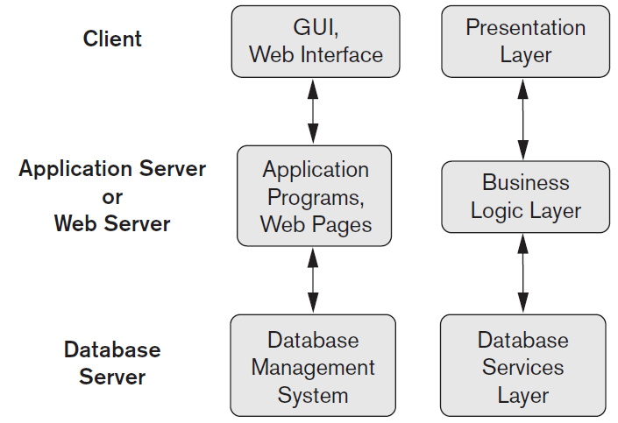
Three-Tier and n-Tier Architectures for Web Applications

Slide 131
Classification of DataBase
Management Systems
first criteria used to classify is the data model on which the DBMS is based
second criterion used to classify DBMSs is the number of users supported
  single-user systems support / multiuser systems
third criterion is the number of sites over which the database is distributed
  centralized / distributed DBMS
    big data systems are often massively distributed, with hundreds of sites; data is often replicated on multiple sites so that failure of a site will not make some data unavailable

Slide 132
two older, historically important data models, now known as legacy data models, are the network and hierarchical models

Slide 133
network model
represents data as record types and also represents a limited type of 1:N relationship, called a set type; a 1:N, or one-to-many, relationship relates one instance of a record to many record instances using some pointer linking mechanism in these models
also known as the CODASYL DBTG model, has an associated record-at-a- time language that must be embedded in a host programming language
proposed in the 1971 by Database Task Group (DBTG) Report as an extension of the COBOL language

Slide 134
hierarchical model
represents data as hierarchical tree structures; each hierarchy represents a number of related records
popular hierarchical model is the IMS system; dominated the DBMS market for over 20 years between 1965 and 1985
DML, called DL/1, was a de facto industry standard for a long time

